Slide 1
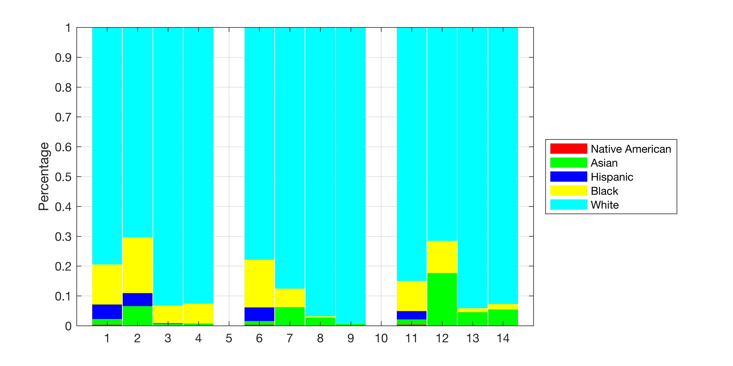
PERCENTAGE
PUBLICATIONS
PUBLICATIONS
U.S. PATENTS
U.S. PATENTS
PUBLICATIONS
CELL LINES
CELL LINES
U.S. PATENTS
U.S. DEATHS
U.S. DEATHS
CELL LINES
U.S. DEATHS
BREAST CANCER
PROSTATE CANCER
LUNG CANCER

Slide 2
 | Breast Cancer |  |  |  | Prostate Cancer |  |  |  | Lung Cancer
 | CDC Deaths | Cell Lines | Publications | US Patents | CDC Deaths | Cell Lines | Publications | Patents | CDC Deaths | Cell Lines | Publications | Patents
Asian | 11697 | 6 | 110 | 73 | 5308 | 1 | 71 | 27 | 38990 | 51 | 452 | 410
Black | 81166 | 17 | 959 | 749 | 67909 | 1 | 11 | 6 | 230231 | 31 | 130 | 139
Hispanic | 29227 | 4 | 24 | 8 | 19239 | 0 | 0 | 0 | 63483 | 0 | 0 | 0
Native American | 2226 | 0 | 0 | 0 | 1538 | 0 | 0 | 0 | 9312 | 0 | 0 | 0
White | 479913 | 64 | 14950 | 10320 | 330428 | 14 | 2488 | 3569 | 1928460 | 206 | 9235 | 6949
 | Breast Cancer |  |  |  | Prostate Cancer |  |  |  | Lung Cancer
 | CDC Deaths | Cell Lines | Publications | US Patents | CDC Deaths | Cell Lines | Publications | Patents | CDC Deaths | Cell Lines | Publications | Patents
Asian | .02 | .06 | .01 | .01 | .01 | .06 | .03 | .01 | .02 | .18 | .05 | .05
Black | .13 | .19 | .06 | .07 | .16 | .06 | .00 | .00 | .10 | .11 | .01 | .02
Hispanic | .05 | .04 | .00 | .00 | .05 | .00 | .00 | .00 | .03 | .00 | .00 | .00
Native American | .00 | .00 | .00 | .00 | .00 | .00 | .00 | .00 | .00 | .00 | .00 | .00
White | .79 | .70 | .93 | .93 | .78 | .88 | .97 | .99 | .85 | .72 | .94 | .93

Slide 3
Definitions
U.S. Deaths
Definition: U.S. Center for Disease Control record of the number of people who died of cancer from 2000-2013.
Answers: Who is in need of higher fidelity treatments?
Cell Lines
Definition: Demographic profile of the commercially available cell lines available to researchers, whoose donor ethnicity is known.
Answers: What is the toolkit available to researchers?
Publications
Definition: Citations of cell lines with known donor ethnicities in Web of Science publications from 1970-2016
Answers: How do researchers use the available toolkit of cell lines?
U.S. Patents
Definition: Citations of cell lines with known donor ethnicities in the U.S. Patent database from 2001-2016
Answers: Which models are used in research that is eventually translated to medical practice?

